Slide 1
Data Manipulation Pt. 2
Jeremy Bergmann - Omaha Data Science Academy

Slide 2
Review: Class 2&3
Class 2 - Queries
Common SQL clauses Common SQL data types Aggregations & Functions SQL Subqueries Practice using SQL by examples in MySQL Workbench - World Schema
Class 3 - Data Manipulation
Create and delete databases
Create and delete tables
Create tables with constraints
Add and delete table fields
Add and delete table constraints
Insert data manually into tables
Import data from SQL and CSV file
Notes:
Feynman technique: Learn -> Explain -> Reflect -> Repeat
What are the most important ideas from last class? Write a summary of the information as if explaining to a 14 year old. Avoid jargon Keep the words and sentences simple Rely on memory Make the explanation visual, if possible Note where you had difficulty or have knowledge gaps. These indicate things you should review, research, or ask questions about

Slide 3
Class 4 Objectives
Part 1 - Data Storage
Create and delete databases
Create and delete tables
Create tables with constraints
Add and delete table fields
Add and delete table constraints
Insert data manually into tables
Import data from SQL and CSV files
Part 2 - Data Manipulation
Create and delete views
SQL Operators, Wildcards, Like, etc.
Case Statements & Logical Functions
Cleaning data - string, numeric and date
Perform joins - inner, outer and left
SQL Union & Union All
Notes:
Feynman technique: Learn -> Explain -> Reflect -> Repeat
What are the most important ideas from last class? Write a summary of the information as if explaining to a 14 year old. Avoid jargon Keep the words and sentences simple Rely on memory Make the explanation visual, if possible Note where you had difficulty or have knowledge gaps. These indicate things you should review, research, or ask questions about

Slide 4
What is the need for data manipulation?
Creating new datasets & Combine disparate data sets
Perform common queries, aggregations, and joins
Adding, removing, or modifying data
Extracting and Storing Data
Creation/Extraction
Transformation data
Cleaning data
Storage & Retrieval
Notes:
Creation: creating tables and databases, the things
Storage: where data are stored
Cleaning: adding, removing, or modifying data
Retrieval: selecting only the data you want

Slide 5
What is a View?
Purpose - A view is a “virtual table” based on the result-set of an SQL statement, saved as a database object for future data creation/extraction.
SQL Views have the following properties:
A view is a named derived table.
CREATE/ALTER/DROP VIEW clauses
Views are not stored and its query must be run every time it is needed.
Used to call up data without changing its underlying base tables.
Example
CREATE VIEW world.vw_countries_asia AS
SELECT tbl.Name AS 'Country'
FROM world.country as tbl
WHERE (tbl.Continent = 'Asia')
View Usage
SELECT country
FROM world.vw_countries_asia
WHERE Country in ('India', 'China', 'Nepal')
Notes:
A derived table is the result of a query that looks like a table.

Slide 6
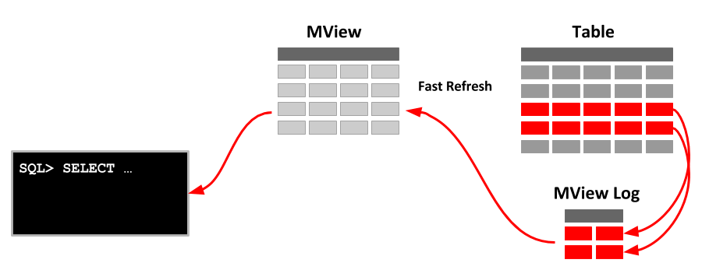
Materialized View
A view that is stored as a database object, containing the results of a query. The view’s calculations are stored as well, so it has increased performance speed. It can be refreshed as the tables it draws from are updated at various intervals. Used to call up or perform calculations on data without changing the underlying base tables.

Slide 7
SQL Operators
Purpose: A comparison (or relational) operator is a mathematical symbol which is used to compare two values, usually in the “where” or “select” clauses of a SQL Query. The result of a comparison can be TRUE, FALSE, or UNKNOWN (an operator that has one or two NULL expressions returns UNKNOWN).
Operator Type | SELECT Clauses
Arithmetic | Add, Subtract, Multiply, Divide
Comparison | Equal to (=), Greater than (>), Less than (<), Greater Than or Equal to (>=)
Logical | AND, BETWEEN, EXISTS, IN, LIKE, NOT, OR
Notes:
“Main clauses” in descending order of operations
LIKE: wildcard searches: %<char>, %<char>%, <char>%, underscores
Wildcard characters: %, _, *
CASE: if-then statements
JOIN: mostly use INNER, LEFT
HAVING: WHERE for groups (http://www.mysqltutorial.org/mysql-having.aspx)
BETWEEN is inclusive

Slide 8
Case Statements
Purpose - The CASE statement goes through conditions and return a value when the first condition is met (like an IF-THEN-ELSE statement). If no conditions are true, it returns the value in the “ELSE” clause.
Syntax
CASE WHEN condition1 THEN result1 WHEN condition2 THEN result2 WHEN conditionN THEN resultN ELSE result END;
Example
SELECT view.Country,
CASE WHEN Country = 'India' THEN 'Gandhi'
WHEN Country = 'Nepal' THEN 'Mt. Everest'
WHEN Country = 'China' THEN 'Great Wall'
ELSE 'Unknown' end as famous_stuff
FROM world.vw_countries_asia as view
WHERE view.Country in ('India', 'China', 'Nepal','Taiwan')

Slide 9
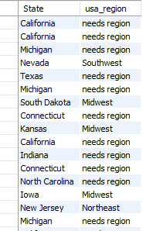
Ex. SQL Operators & Case Statement
Classify US States into their geographical “regions”
SQL Query
SELECT District as State, case when District in ('Nebraska','Iowa','Missouri','Kansas') then 'Midwest' when District in ('New York','Massachusetts','New Jersey') then 'Northeast' when District = 'New Mexico’ or District = 'Nevada' then 'Southwest' when District like ('%Dakota') then 'Midwest' else 'needs region' end as usa_region FROM world.city where CountryCode='USA'
Blue - Operators, Green - Case Statement
Notes:
“Main clauses” in descending order of operations
LIKE: wildcard searches: %<char>, %<char>%, <char>%, underscores
Wildcard characters: %, _, *
CASE: if-then statements
JOIN: mostly use INNER, LEFT
HAVING: WHERE for groups (http://www.mysqltutorial.org/mysql-having.aspx)
BETWEEN is inclusive

Slide 10
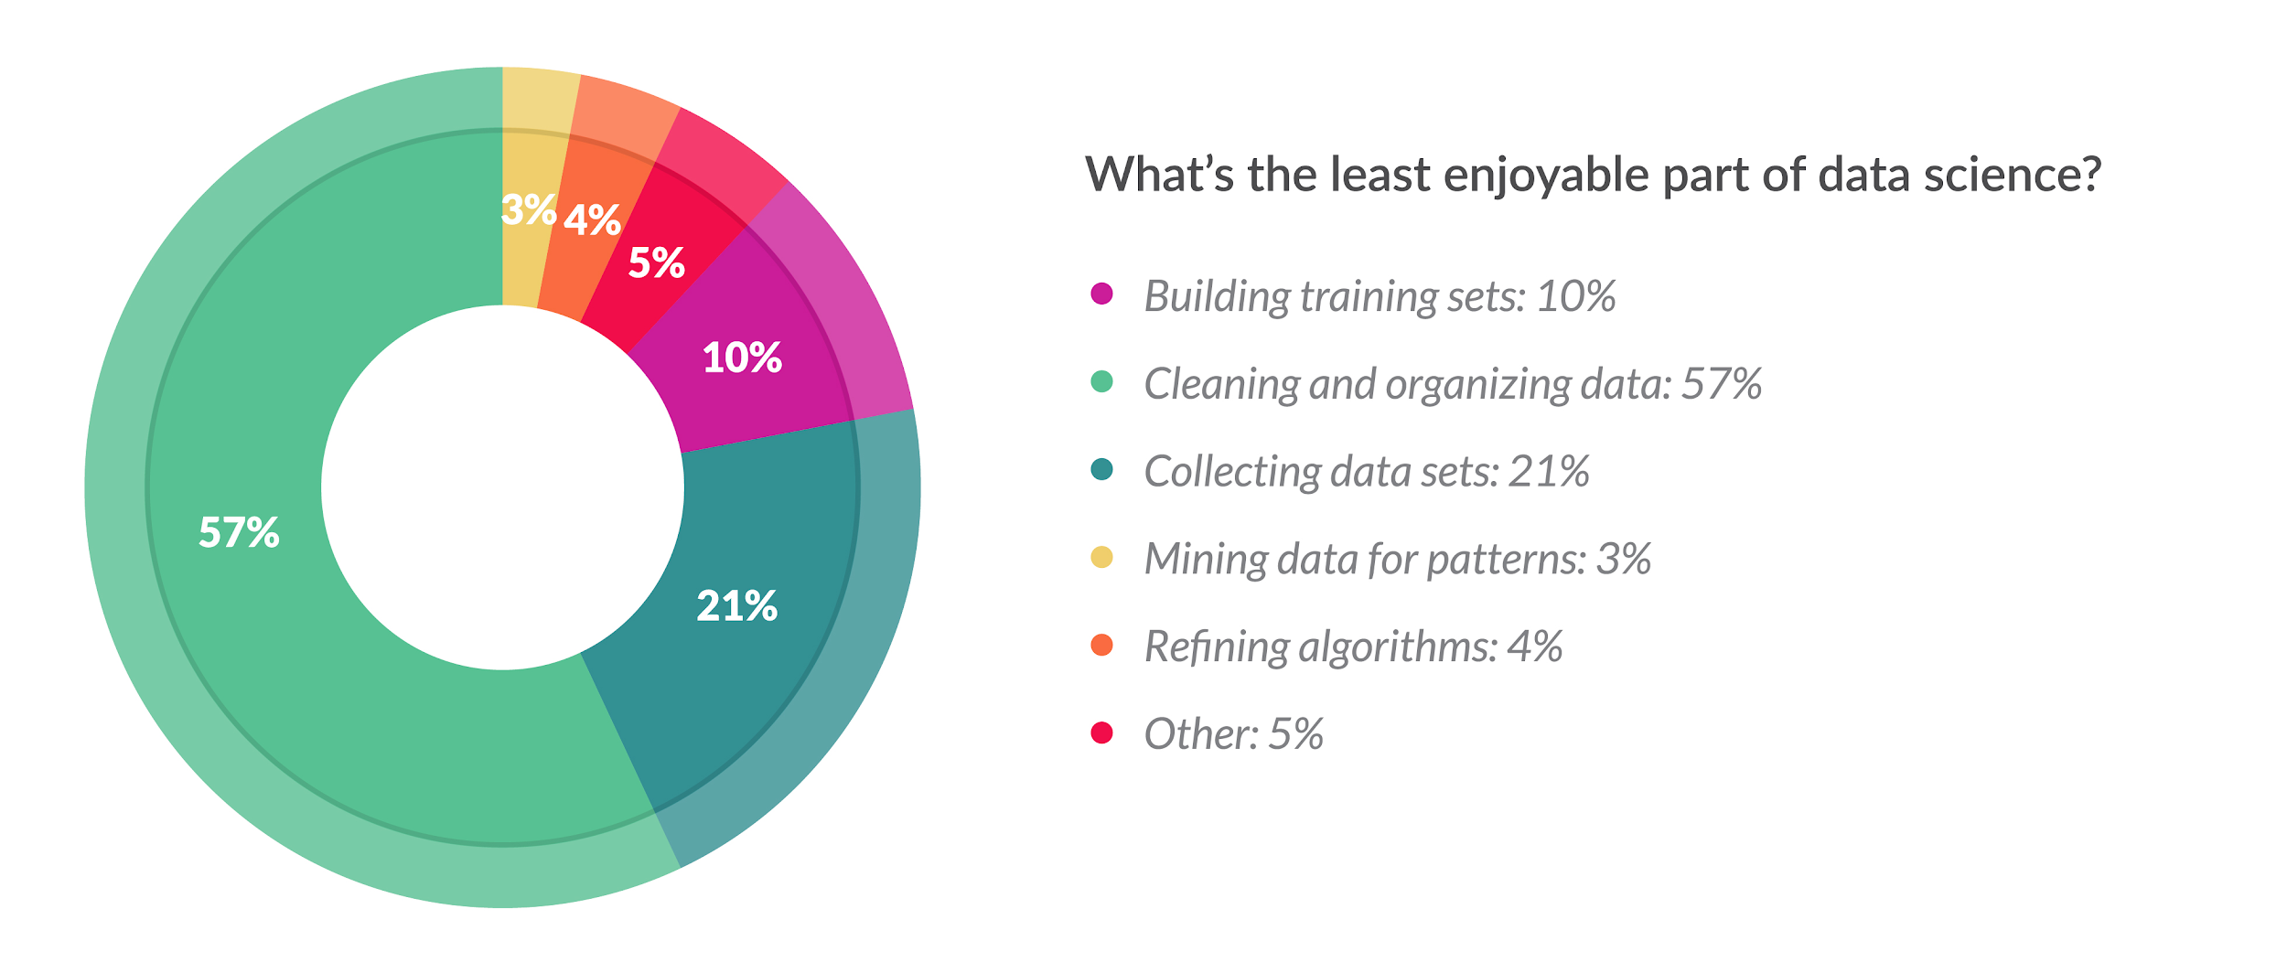
Cleaning Data
What Does Cleaning Data Mean?
Data cleaning is the process of confirming the Validity, Accuracy, Completeness, Consistency, and Uniformity data
How Can You Clean Data?
You can either use software tools or a coding language to clean data.
What About Programming Languages?
Cleaning data in a language like SQL or Python gives you flexibility to run routines for specific projects, while keeping costs low
Python: Pandas, Dora, datacleaner, tabulate, scrubadub, and many other Python libraries.
SQL: T-SQL, Text & Date Functions, Case Statements, “Where” clause, Select Distinct
Notes:
What Does Cleaning Data Mean?
This process affects the insights you gain from the data you’ve collected, and makes a huge difference when it comes to performing statistical analysis and machine learning.
What Tools Are Available?
Many tools exist, like Alteryx, Talend, Google OpenRefine, Trifacta Wrangler, and more. These typically have a front-end GUI and can be simpler to run routines.

Slide 11
Goals of Cleaning Data
Remove Unwanted Observations for your dataset, including duplicate and irrelevant observations
Duplicate Observations arise when you combine datasets from multiple places, scrape data, and receive data from clients/other departments.
Irrelevant Observations & Outliers are those that don’t fit the specific problem you’re trying to solve. It may be useful in other projects, but not this particular one.
Fix Structural Errors that occur during measurement or data transfer. This can be something as simple as multiple ways to spell a word or mislabeled classes; Parsing is an example of finding syntax errors.
Handle (Append) Missing Data is a must. It’s bad practice to ignore missing values in your dataset, because many algorithms do not accept missing values. You have two options when handling missing data:
Dropping observations that have missing values
Imputing the missing values based on other observations. Appending is a method of cross-referencing multiple data sources and combining known data into a final data.
There are other possible ways to clean data, such as, transforming files, applying statistical methods, and post-processing, but these four steps will always be performed on any dataset you will analyze.
Notes:
The goal of cleaning is ultimately to confirm the Validity, Accuracy, Completeness, Consistency, and Uniformity of the dataset.
There are 4 main methods of cleaning data:

Slide 12
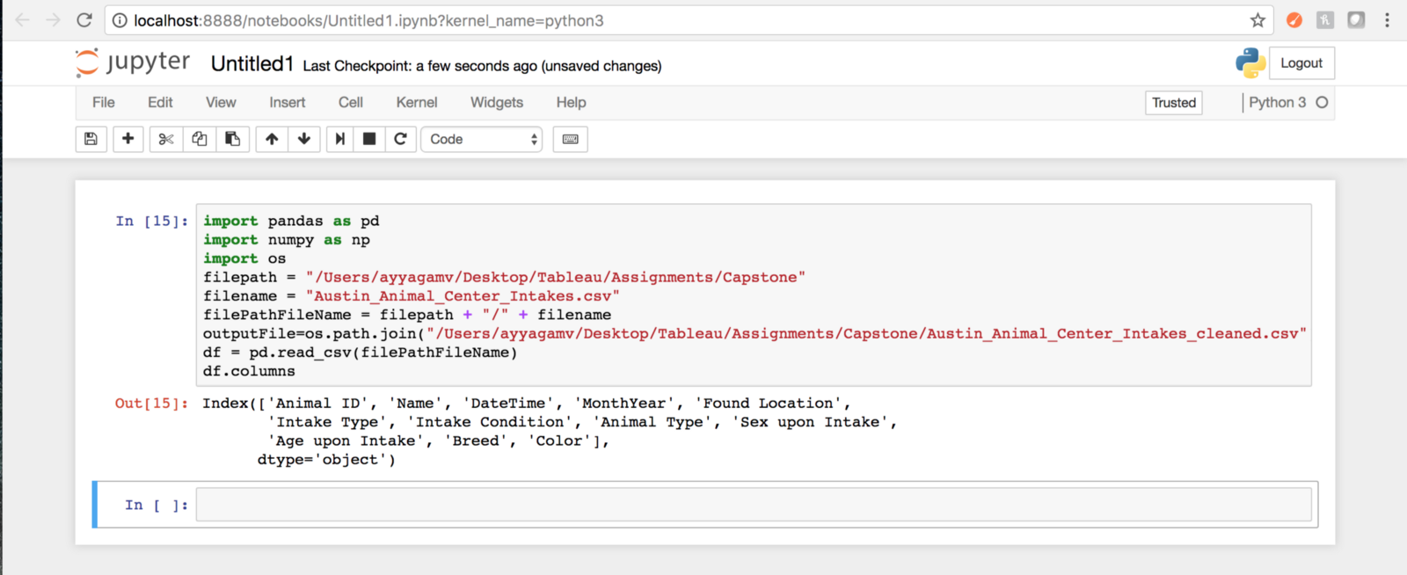
Cleaning data: Python
Data scientists spend a large amount of their time cleaning datasets and getting them down to a form with which they can work. In fact, a lot of data scientists argue that the initial steps of obtaining and cleaning data constitute 80% of their job.
Tasks - Using Pandas Library
Dropping unnecessary columns in a Pandas DataFrame
Using .str() methods to clean columns
Using the DataFrame.applymap() function to clean the entire dataset, element-wise
Renaming columns to a more recognizable set of labels
Skipping unnecessary rows in a CSV file
Resource: Python for Data Analysis (O’Reilly)
Notes:
Common ways to clean data with Python are available in the many libraries that you can import in your code. One of the most popular libraries is Pandas, which was designed for data manipulation and analysis, but is most commonly associated with data cleaning. Here is a common code snippet where Pandas is imported to clean a set of data:

Slide 13
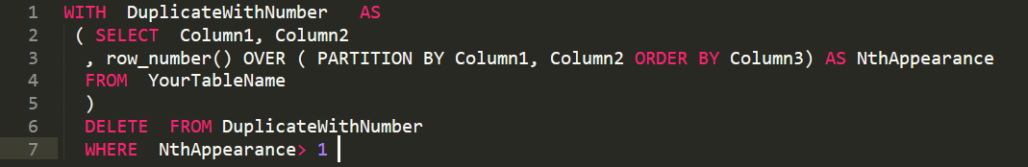
Cleaning data: SQL
You can also use SQL language to clean data in your database. There are several scenarios why you might need to clean your dataset:
Data is present that doesn’t fit the data schema
There is data with invalid records
Some data may be invalid
This is an example set of code that’s meant to remove duplicates from a table:
*Cleaining Strings in python: https://mode.com/sql-tutorial/sql-string-functions-for-cleaning/
Notes:
Format for readability
FROM: what table to read
SELECT: what columns to get
AS: rename the column
GROUP BY: combine rows by column value
ORDER BY: sort in ascending or descending order
LIMIT: constrain the number of rows displayed

Slide 14
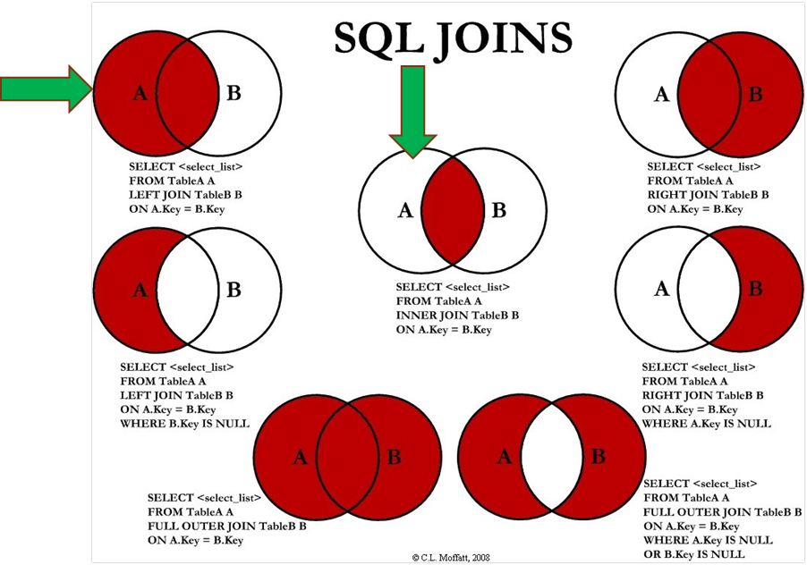
How do you combine data?
Answer:
SQL Joins can be done using WHERE or JOIN clauses!
Notes:
Most Common - INNER & LEFT, Sometimes Full Outer

Slide 15
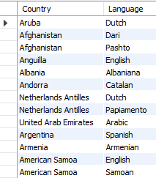
Inner Join - Example
Syntax SELECT <columns> FROM <table> AS <alias> <join type> JOIN <table> AS <alias>
ON <table alias>.<table column> = <table alias2>.<column>
Example - Official Languages SELECT a.Name as Country, b.Language FROM world.country as a INNER JOIN world.countrylanguage as b ON a.code = b.countryCode and b.IsOfficial ='T'

Slide 16
Left Join - Example
Question: “Which countries do/do not speak English as a language?”
Example
SELECT a.Name as Country, b.Language FROM world.country as a LEFT JOIN world.countrylanguage as b ON a.code = b.countryCode and b.`Language` ='English'
Notes:
Security: databases have additional security measures
Data integrity: data changes require intent
Customization: you can organize it best on your needs
Recovery: you don’t lose the data if there’s a catastrophic error
Learning curve: you have to learn how to manipulate it
Abstract: a less visual representation and demands more from the user

Slide 17
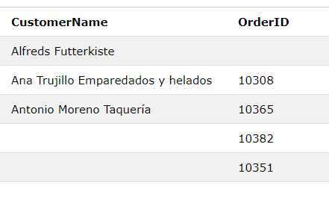
Full Outer Join - Example
Question: “List all Customer and Order Name, regardless of a customer placing an order, or an order without a customer name”
Example
SELECT a.CustomerName, b.OrderID FROM Customers as a FULL OUTER JOIN Orders b ON a.CustomerID=b.CustomerID ORDER BY a.CustomerName;

Slide 18
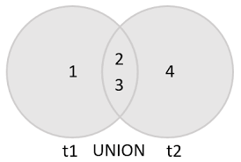
SQL Union & Union All
Purpose: The UNION operator is used to combine the result-set of two or more SELECT statements.
Each SELECT statement within UNION must have the same number of columns
The columns must also have similar data types
The columns in each SELECT statement must also be in the same order

Slide 19
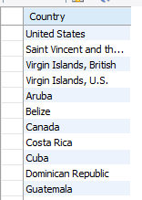
SQL Union & Union All
Question: “List all countries in North America that speak English or Spanish as a language, with no duplication.
Example
SELECT a.Name as Country FROM world.country as a Inner JOIN world.countrylanguage as b ON a.code = b.countryCode and b.`Language` ='English' Where a.Continent = 'North America' Union all SELECT a.Name as Country #, b.Language FROM world.country as a Inner JOIN world.countrylanguage as b ON a.code = b.countryCode and b.`Language`='Spanish' Where a.Continent = 'North America'

Slide 20

Exercises
SQL Operations & Data Cleaning
1. Create a query using the “world” schema that utilizes as many SQL operators as possible.
2. Import a list of non-standard addresses, then use case statements to standardize them in a similar format.
3. Utilize the ifnull() function on a column to replace null values with the one of your choice. (must be same data type!)
SQL Joins & Unions
1. In the “world” schema, obtain the name of all cities in North America that have a population over 1M, where the primary language is English.
2. Using world.country table, combine all countries (repeating) with a life expectency of > 70 years or a GNP > 100000

